Slide 1

BONFIRE NIGHT

Slide 2
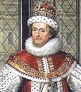
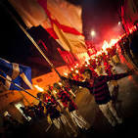
ORIGIN
In Great Britain, Bonfire Night is associated with the tradition of celebrating the failure of Guy Fawkes' actions on 5 November.
This Bonfire Night also has its roots in the sectarian struggle between Protestants and Catholics.
It celebrates the Battle of the Boyne of 1690, in which the Protestant William of Orange defeated the Catholic James II.

Slide 3

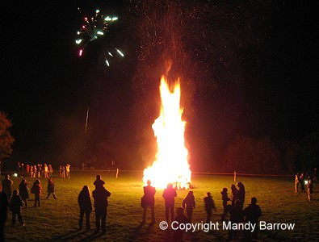
WHAT IS?
Bonfire Night is an annual event dedicated to bonfires fireworks and celebrations. Sometimes known as St John's Eve, a similar bonfire tradition survives in parts of Scandinavia and is known as Walpurgis Night; in Australia, the Queen's Birthday.
Several other cultures also include night-time celebrations involving bonfires and/or fireworks.

Slide 4
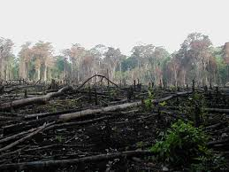
ENVIRONMENTAL IMPACT
Bonfire Night celebrations can pose a risk to public safety due to the possibility of fires, injuries, or fights. For example, in London calls to firefighting services are nearly tripled on Bonfire Nigh
The tradition of Bonfire Night has been criticized for its environmental impact.

Slide 5
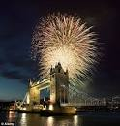

WHERE IS IT CELEBRATED?
Celebrations are held throughout Great Britain, in parts of Northern Ireland, and in some other parts of the Commonwealth

